Slide 1

Notes:
Hello kon papa!!
Waking up each morning feeling energized, with a spring in your step and a clear mind, ready to start the day.
That's the power of healthy and well-balanced food!!
Who wants to learn more? (Raise your hand)

Slide 2
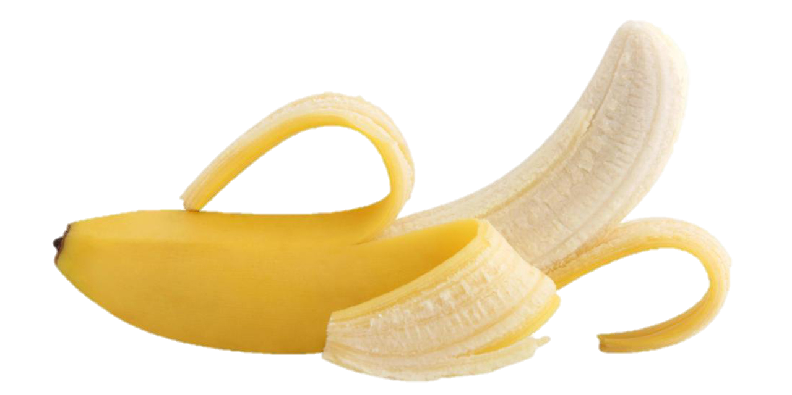
HEALTHY FOOD
HOW CAN FOOD IMPACT
YOUR BODY & MIND?
Notes:
Today, I’m “KHLORP VEAK “ from PNC,
I stand before you today to convince about the remarkable benefits of adopting a healthy food lifestyle.

Slide 3

IS​​ THAT
THE NORM?
Notes:
In a world where fast food and processed meals have become the norm, it's crucial to recognize the advantages that healthy eating can bring to our lives.
So, let me prove you today that healthy food is about good health, good mental and give you more productivity in your studies

Slide 4
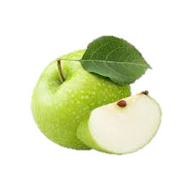
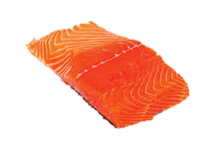

What your body needs mostly is…
50%
20%
30%
Notes:
Most of the nutriments required by your body comes from:
Fruit and vegetable
Whole grains
Proteins
So, a balanced diet packed with fruits, vegetables, whole grains, and lean proteins provides us with essential nutrients, vitamins, and minerals.
These nutrients help strengthen our immune system, reducing the risk of illness and ensuring our bodies function optimally
But
Let s prove it with science!

Slide 5

Essential foods help the body is...
Brain
Body
Antioxidants
Notes:
Research suggests that certain nutrients found in healthy foods, such as omega-3 fatty acids and antioxidants, play a vital role in supporting brain health and reducing the risk of cognitive decline.
Studies have shown that individuals who consume a nutritious diet are less likely to experience mental health disorders such as depression and anxiety.

Slide 6
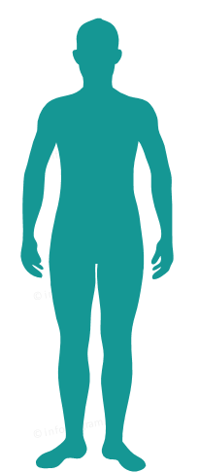

Consuming Fruits reduce risks for diabetes
Impact
Benefits
Notes:
A recent study has proved that a healthy diet can lower the risk of chronic diseases like:
heart disease
diabetes
certain types of cancer
As you can see on this graph, the people with a balanced have 4 time less diabete than people eating fast food every day

Slide 7
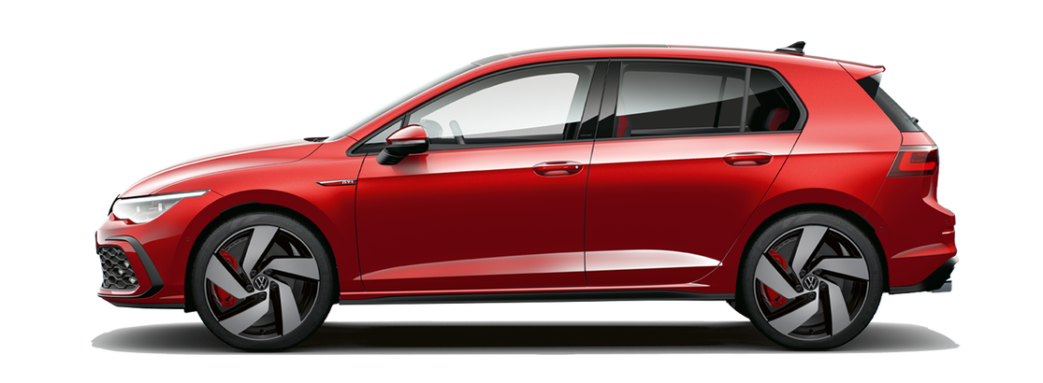
You need gas to drive a car, right?
Notes:
You need gas to drive a car, right?
As a car, healthy eating fuels our bodies and minds, enhancing our energy levels and productivity.
So, I urge each one of you to prioritize your health and make conscious choices when it comes to the food you consume!

Slide 8
THANK YOU?

